Slide 1
DATA ANALYSIS USING EXCEL
SALES ANALYSIS
AKASH V

Slide 2
DATA CLEANING
Used power query to clean and transform the data.
Apply necessary steps such removing duplicate, Splitting columns and changing data type.

Slide 3
CALCULATION
Calculated the following
Revenue =Unit sold*Unit price
Total cost=unit sold*unit cost
Profit=Revenue-Cost
Gross profit=unit price-unit cost
Gross margin=Gross profit/unit price*100
Average revenue per unit=revenue/unit sold
Average profit=profit/unit price
cost saving=unit cost-unit sold
profit sensitivity=gross profit/gross margin
Calculation
Revenue for Every year
=sumif(Year range,2016,revenue)
Profit based on item
=vlookup(item,table_array,column_ind,0)

Slide 4
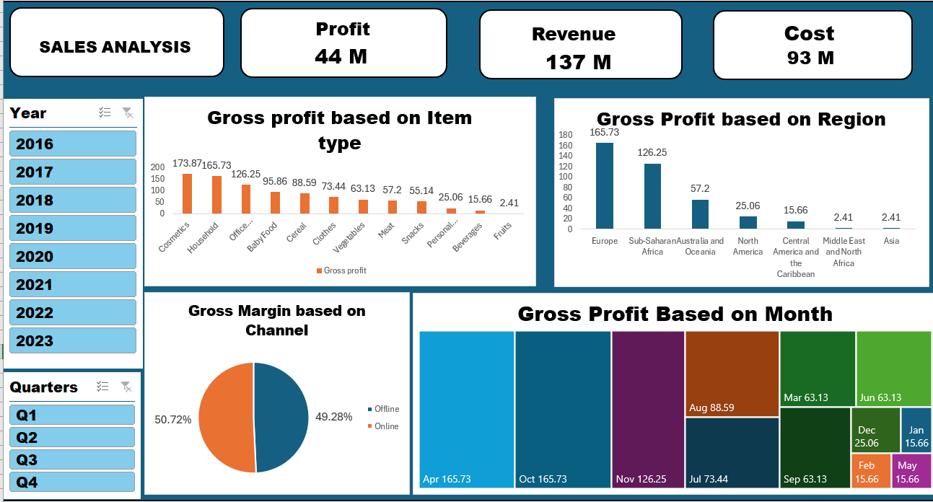
VISUALIZATION

Slide 5
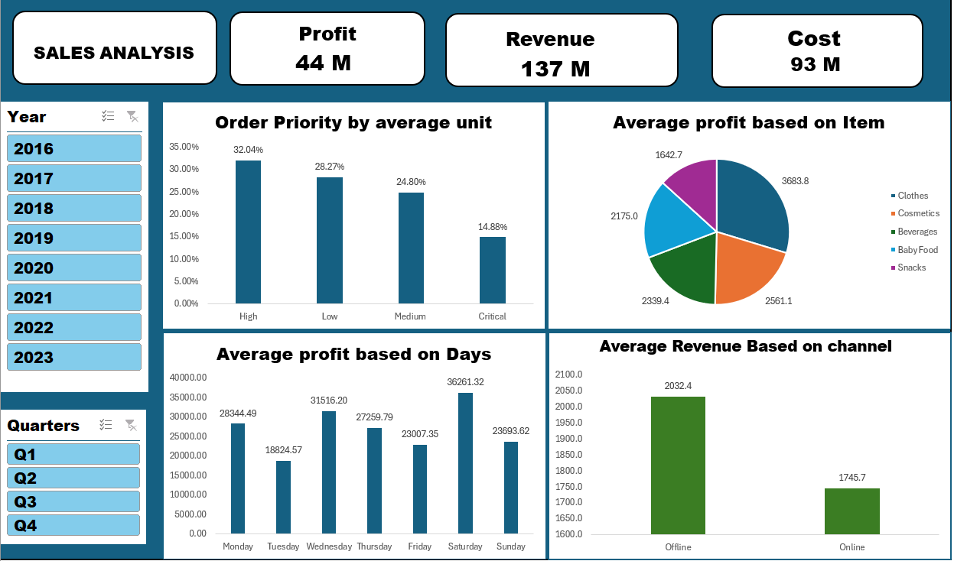

Slide 6
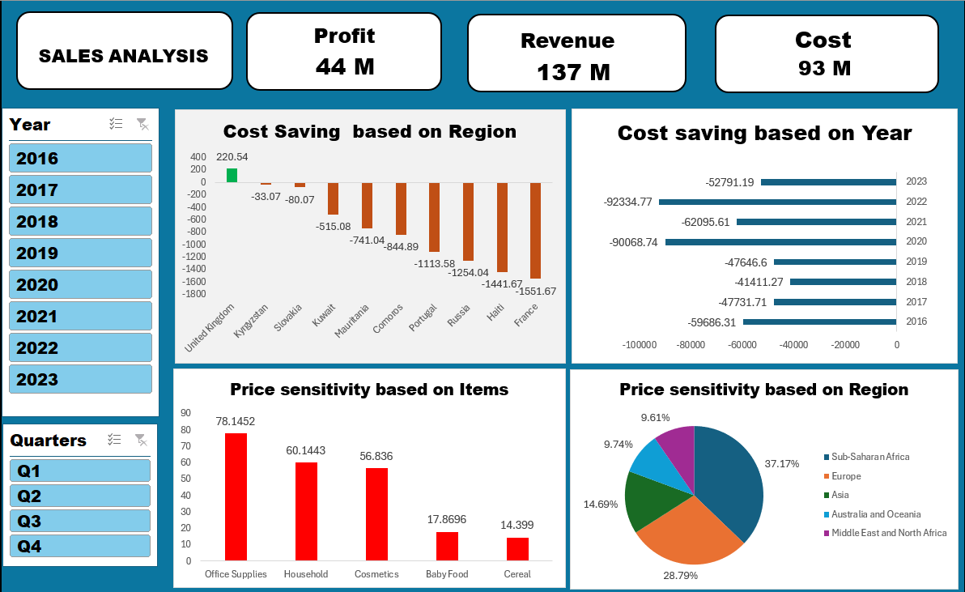

Slide 7
INSIGHTS
Total revenue:
Started at 19M in 2016 and reached 32M in 2023
It was a impressive growth
Total Profit
started at7 M in 2016 and reached 9 M in 2023
Revenue and Profitability
Cosmetics is the highest product based on Gross Profit
Europe region has the highest profit
Online shopping has gained high Gross profit
April month has highest Gross Margin

Slide 8
Sales performance:
High order priority with 32.04%
Clothes has the highest average profit
Saturday has highest average profit every month
Offline shopping received average revenue of 2032.5
Cost Optimization
United kingdom is the only country with high cost saving
Office supply has highest price sensitivity
Africa has highest price sensitivity

Slide 9


